Slide 1
Data Analysis of Sinter Plant, Tata Steel
Krishna Deshpande
VIT
2023

Slide 2
Background
Tata Steel, Jamshedpur is an integrated steel plant where Steel is produced from Iron Ore, through a chain of multiple process.
Sintering is one of the vital process as explained in the sketch below
Iron Ore
Heating & Melting
Iron Ore > Crude Liquid Iron
Rolling
Refining
Crude Iron > Liquid Steel
Solidification
Liquid Steel > Sold Steel
Hot Rolled Products
Sinter
Blast Furnace
Liquid Crude Iron
Steel making
Casting
Solid Steel
Cold Rolled Products
Coke

Slide 3
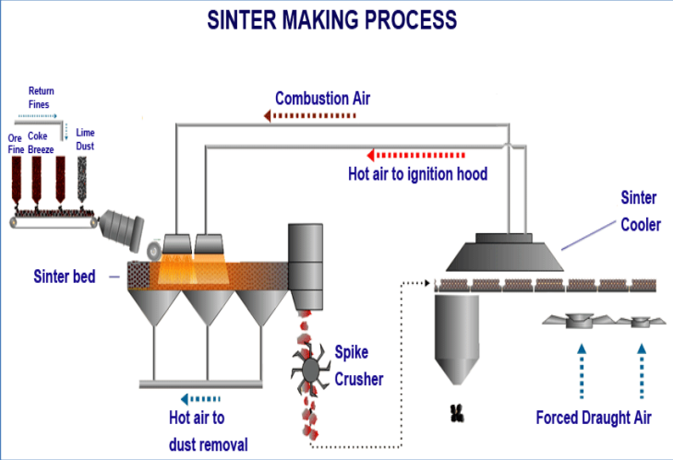
Why Sintering
Iron ore and coke are fed into the blast furnace to obtain crude liquid iron.
Blast furnace is a very tall structure, which cannot take iron ore fines, as it will choke the blast furnace.
However, from Iron Ore mines, large quantity of fines are generated.
To use these Iron Ore fines Sintering process has been developed.

Slide 4
About Sinter Process
In sintering, we put all the small size (less than 8mm) iron ore onto the moving conveyer, with them we add coke. To make them stick together, we give them hot air from above and a exhaust from below to suck out the air so that the coke and small size of iron ore are only exposed to the hot air.
This technique is carried out till the temperature reaches between 1300-1480 degree C.
The temperature gradually increases as the mixture goes over the moving conveyer.
The temperature is very crucial so that the iron doesn't melt but also doesn't stay too cold so that they don't agglomerate to form a big chunk
Then the new big sized iron sinter go through a spike crusher which makes them into relevant sized chunks which are needed for the blast furnace.
There are many important components to this process. Speed of the conveyer, content of iron ore vs coke in the mixture, temperature, size of iron ore, etc.

Slide 5
Objective
Sintering plant generates lot of data, however this data was not analyzed in structured manner and hence was not very useful for the operations team.
The objective of this project was to use different machine learning models to analyze the Sinter Plant Data and put the outcome in structured manner which can be useful to the relevant department personnel.

Slide 6
Data Set
This projects Data set was given by my mentor, Nitish Kumar Sir.
It was a data set of 1 month of the Sinter Plant.
It had 14 feature with CLOCK (Time) and the output with it.

Slide 7
Steps Followed in this task
Data Preprocessing
Exploring the given data and Cleaning the data.
Data Modeling
Model Optimization

Slide 8
Data Preprocessing
Using data.info(), we found we have no null values in our data set and we have a total of 5000 entries in each column.
I noticed we have a column called ‘CLOCK’ with its values data type as ‘object’, we converted it to datetime64.

Slide 9
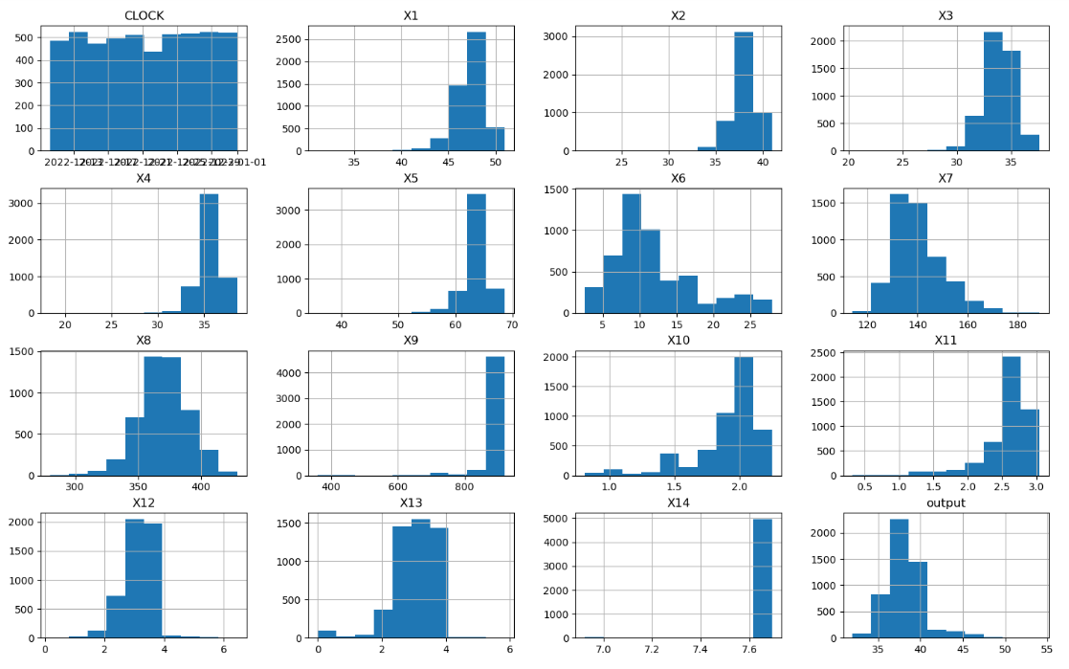
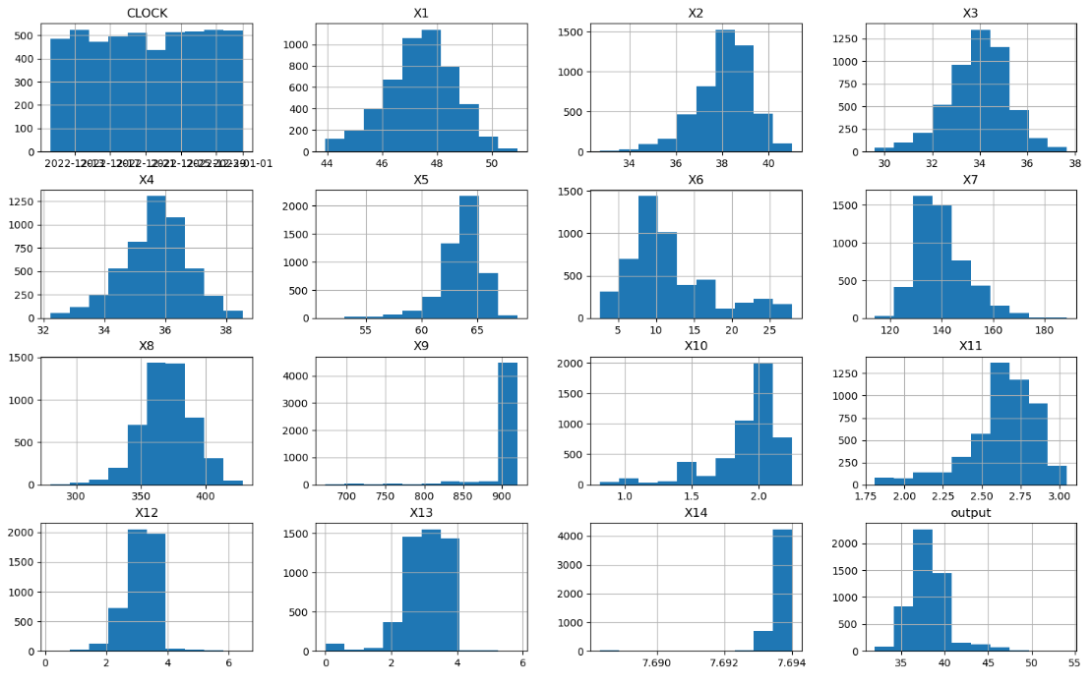
Exploring the given data and Cleaning the data.
Before removing outliers
After removing outliers

Slide 10
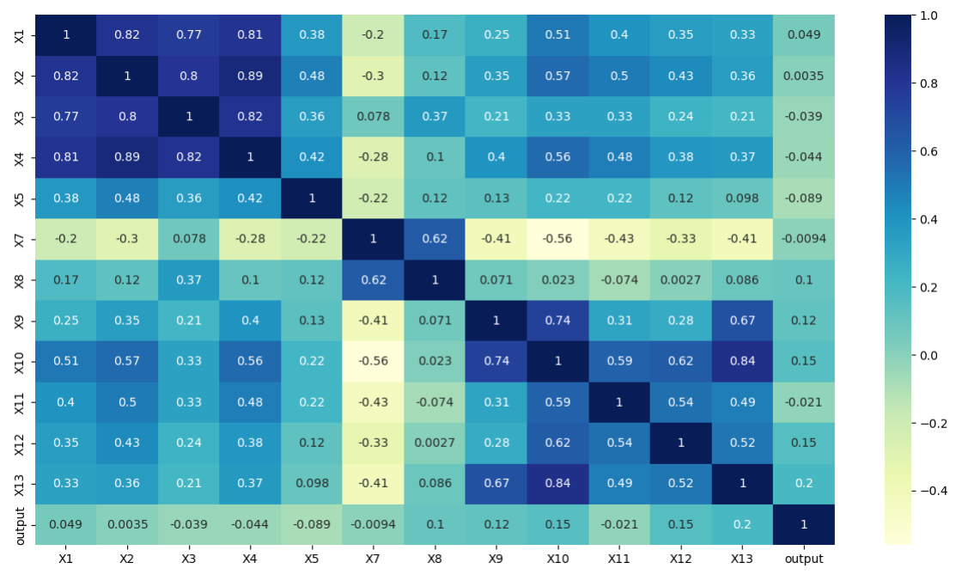
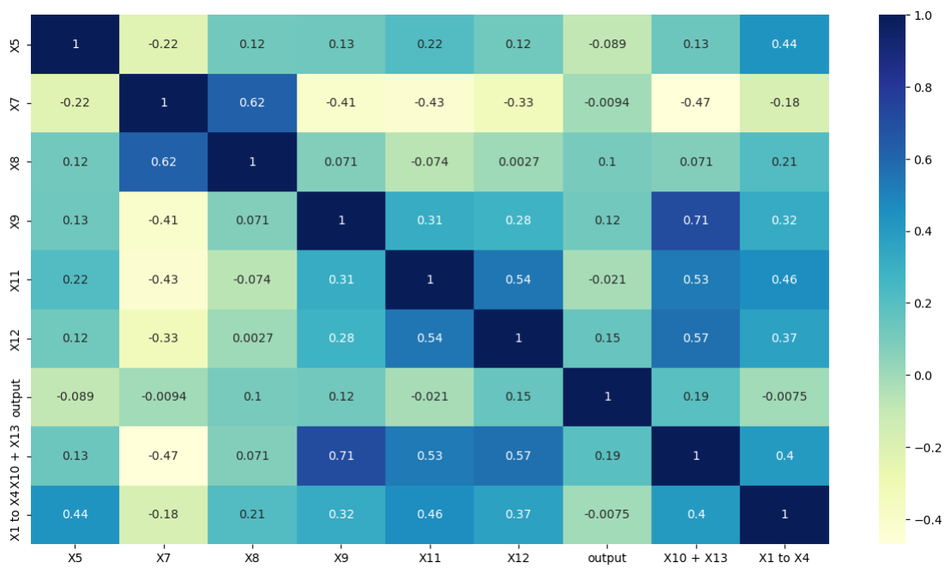
Feature Creation
Before doing Feature Creation
After doing Feature Creation

Slide 11
Model Training
Regression Models used for this task:
Linear -> 0.08(Train)/ 0.1 (Test)
Random Forest -> 0.96(Train)/ 0.78 (Test)
SVR -> 0.262(Train)/ 0.261 (Test)
Ridge -> 0.08(Train)/ 0.1 (Test)
Lasso -> 0.069(Train)/ 0.077 (Test)
LARS -> 0.069(Train)/ 0.077 (Test)
Gradient Boosting -> 0.48(Train)/ 0.41 (Test)
XGBoost -> 0.46(Train)/ 0.39 (Test)
Elastic Net -> 0.079(Train)/ 0.091 (Test)
Bayesian Ridge -> 0.087(Train)/ 0.1 (Test)
Kernel Ridge -> 0.45(Train)/ 0.048 (Test)
SGD -> 0.085(Train)/ 0.097 (Test)
Decision Tree -> 1.0(Train)/ 0.69 (Test)
adaboost -> 0.9999(Train)/ 0.825 (Test)
Applying models to check which model suits better to the given data.
Out of all the models used Gradient boosting, Kernel Ridge and XGBoost gave the best result (Decision Tree and adaBoost gave weird result(this high result without parameterization was new to me so…)).

Slide 12
Model Optimization
We saw a significant increase in result after doing optimization of the models which had high results as compared to others.
We used Grid Search CV and Randomized Search CV methods.
We also did k-fold Validation after using the above techniques.

Slide 13
Gradient Boosting Regressor
Grid Search CV Training data => 0.8561 Testing data => 0.7242
Randomized Search CV Training data => 0.8907 Testing data => 0.7229
K – Fold validation Training data => 0.6318 Testing data => 0.3800
The best results of the Model Optimization I used on this ML Model.

Slide 14
XGBoost Regressor
Grid Search CV Training data => 0.8930 Testing data => 0.7191
Randomized Search CV Training data => 0.9220 Testing data => 0. 7970
K – Fold validation Training data => 0.6369 Testing data => 0.3764
The best results of the Model Optimization I used on this ML Model.

Slide 15
Grid Search CV (best results)
Gradient Boosting Regressor
XGBoost Regressor
Training data => 0.8561
Testing data => 0.7242
Training data => 0.8930
Testing data => 0.7191

Slide 16
Randomized Search CV (best results)
Gradient Boosting Regressor
XGBoost Regressor
Training data => 0.8907
Testing data => 0.7229
Training data => 0.9220
Testing data => 0. 7970

Slide 17
K-fold Validation (best results)
Gradient Boosting Regressor
XGBoost Regressor
Training data => 0.6318
Testing data => 0.3800
Training data => 0.6369
Testing data => 0.3764

Slide 18
Conclusion
Data generated at Sinter plant could be analyzed by using 14 Machine Learning Models.
XG Boost and Gradient Boosting Regressor gave the best results.
These 2 ML models gave the accurate prediction for the given data fed.
Best Value obtained was 79% using XG Boost with Randomized Search CV.

